Slide 1

Theater Ticketing System Proposal
By Chakrapani Suresh, Ninh Nguyen, Priyanka Katre, and Ruchi Isaac

Slide 2

Background Summary
Client: Medallion Theatre
Problem: Utilize a manual system to register and keep track of customers, customer information, and tickets to theatre production event.
Prior Issue: "Dr. Thomas Waggoner reserved center orchestra seating tickets for he and his wife for a showing of Les Miz’ more than two months ago, and for some reason the box office couldn’t find his reservation and had sold his tickets to another patron."
Seat Reservation- D18 and D19 via phone reservation.
On phone list, but not transferred to master seating chart.
It happens at least once a week.

Slide 3


System Requirements

Slide 4
Webpage Design
New computer system (ticket system)
To organize the process and keep track of data.
Requirements:
User Interface
Customer information
Ticket and seat registration for event
Payment
Checkout and Confirmation
Client's Computer System:
User interface (above)
Data storage
Customer information
Ticket and seats
Resources:
Data Flow Diagrams
Entity-Relationship Diagram

Slide 5

Team members
Chakrapani Suresh (Project Manager)
Ninh Nguyen (System Analyst)
Priyanka Katre (Software Developer)
Ruchi Isaac (Technical Specialist)

Slide 6

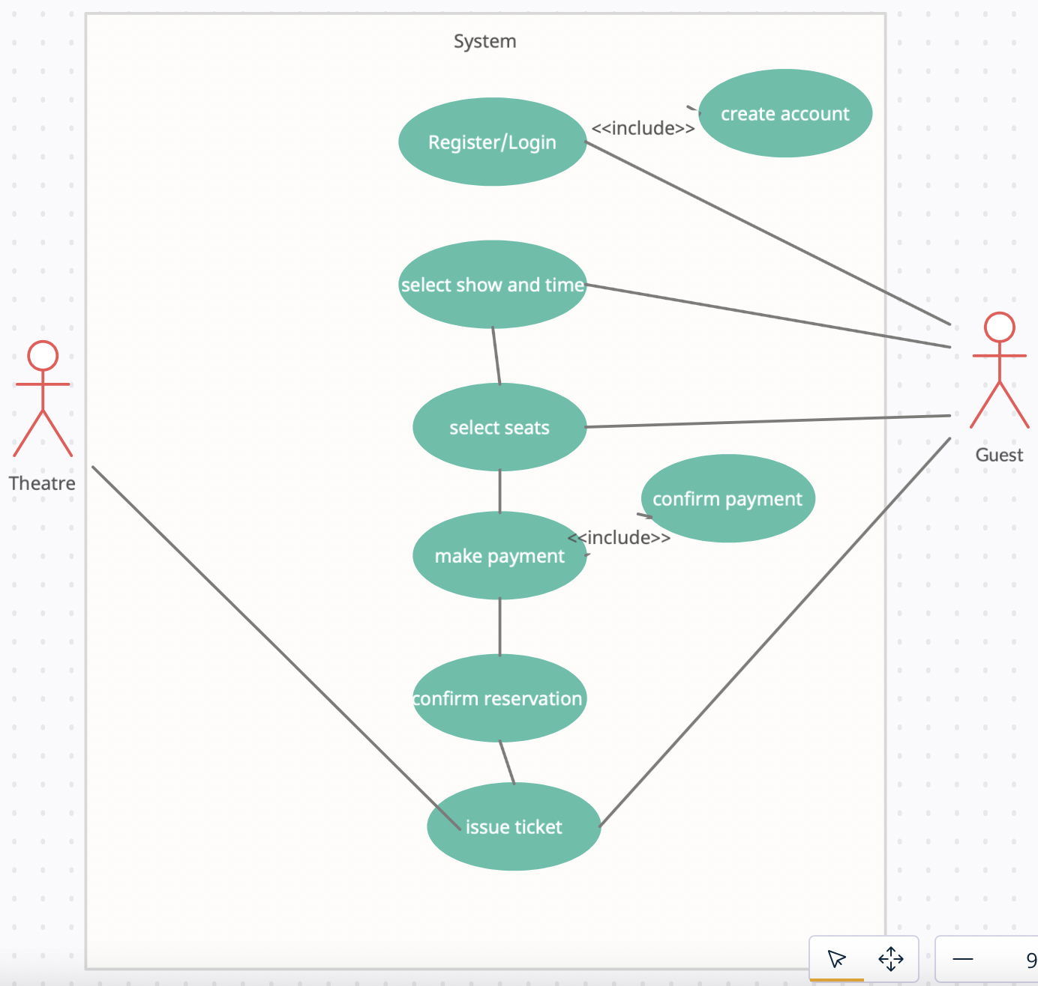

Proposed Process Models
Use case diagram

Slide 7
Use case scenario
Use case name: Ticket reservation.
Area: Show management
Actor(s): Guest, Theater database, Theater management
Stakeholder: Theater’s organization, Show Producers
Level: Clam or Black
Description: Guests logs in and book their tickets for show, time and date of their choice and get a ticket with confirmation number.
Triggering Event: Guests wants to reserve seats for the show of their choice.
Trigger type: External
Steps Performed (Main Path) | Information for Steps
Guest signup or login to the website Guest details from theater database are fetched. Show details are fetched and displayed to the guest. Guest selects show, date and time, and seats of their choice. Guest makes a payment Payment and reservation details are logged into theater database and unique ticket number is generated. Guest is displayed a copy of ticket. | Guest id and password Guest id, name, address and payment modes Show name and Screening times. Seat number, show times. Card details. Guest id, guest name, show name, seat number, show time, ticket number Ticket details.
Preconditions: Guest has access to website.
Postconditions: Guest have successfully reserved their seats and completed transaction.
Assumptions: Guest know their credentials, and show they want to watch.
Requirements Met: Guest can book and view their tickets.
Priority: High.
Risks: Medium

Slide 8
Proposed Process Models
Data Flow Diagram(s)
Context
0
Child
Logical
Physical

Slide 9
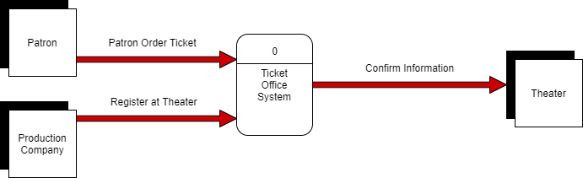

Slide 10
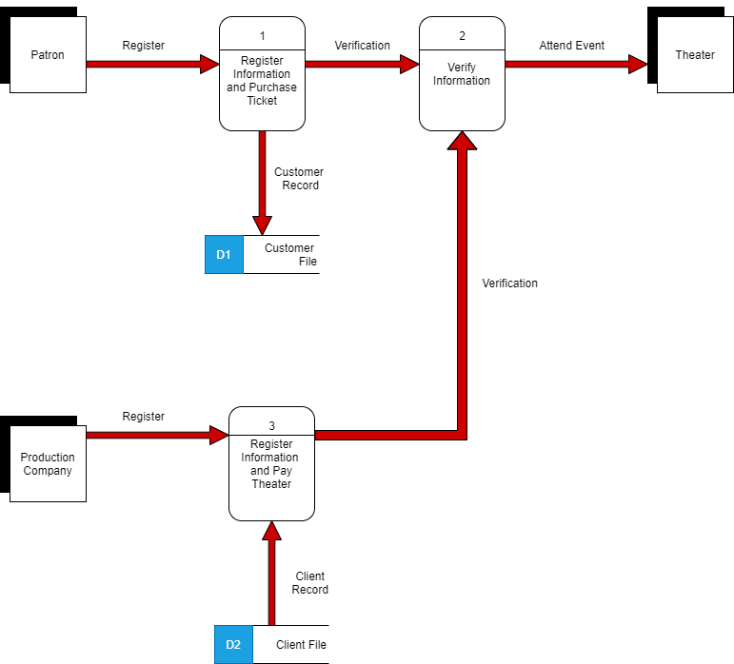

Slide 11
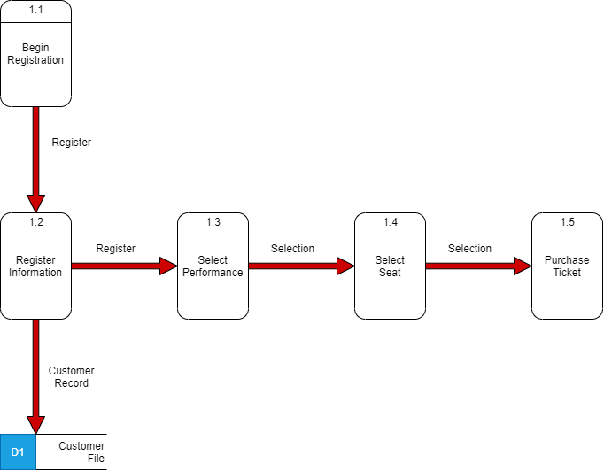

Slide 12
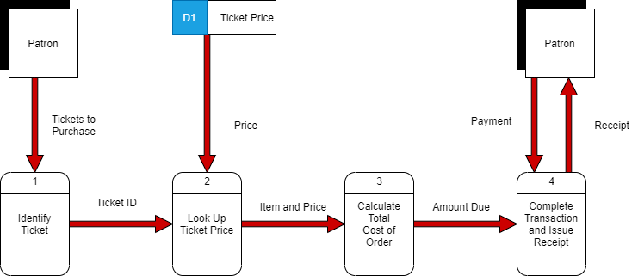

Slide 13
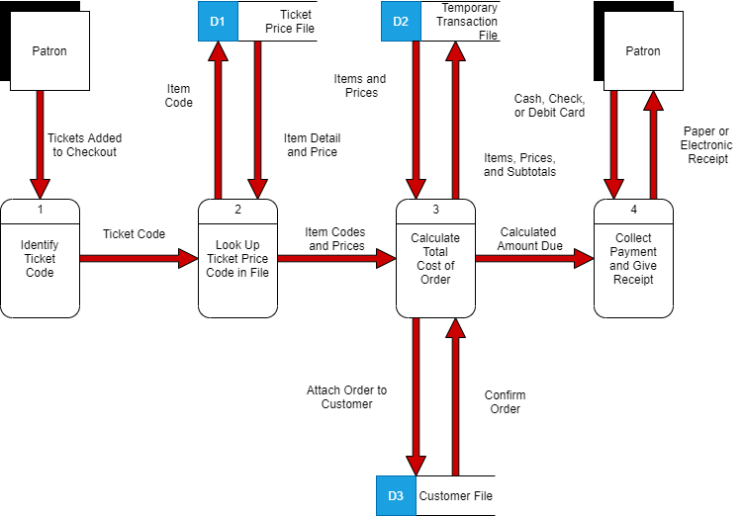

Slide 14
Proposed Data Model

Slide 15
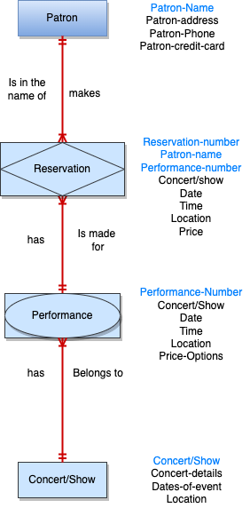

Slide 16
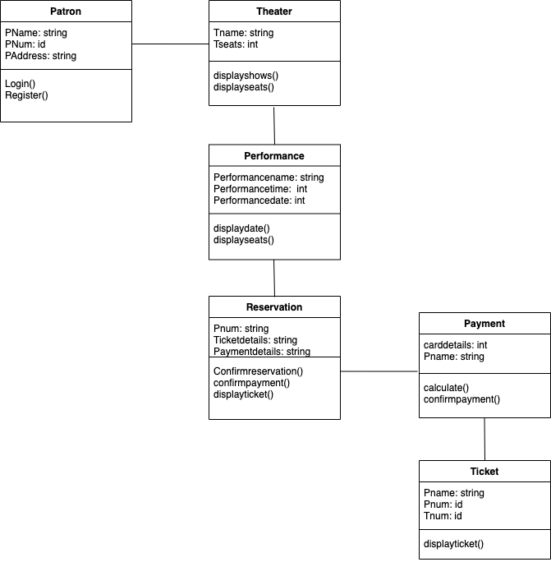
Class Diagram:

Slide 17


User Interface Design
This Photo by Unknown author is licensed under CC BY-SA-NC.

Slide 18
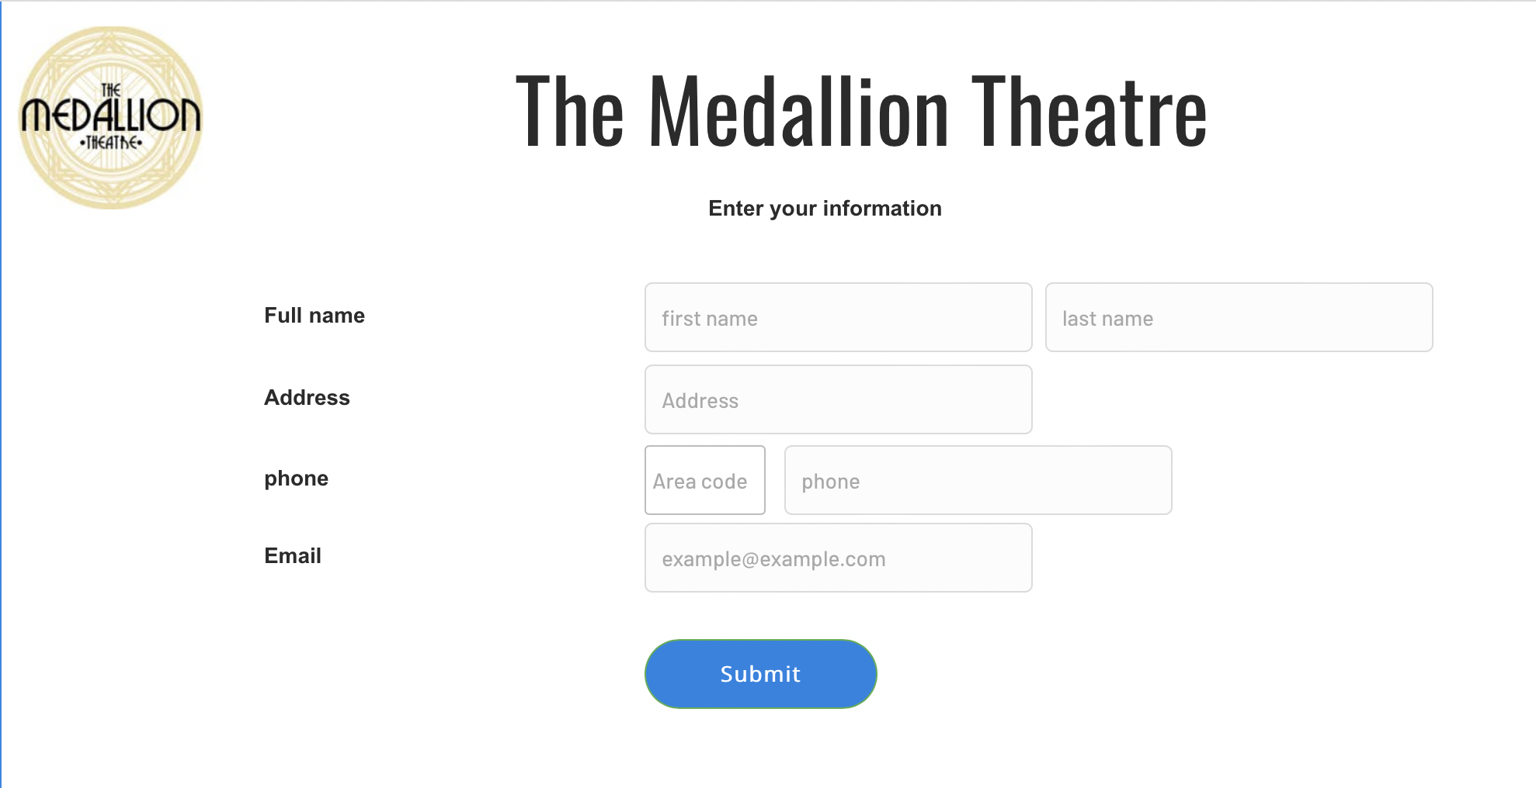
User Interface Design
This Photo by Unknown author is licensed under CC BY-SA-NC.

Slide 19
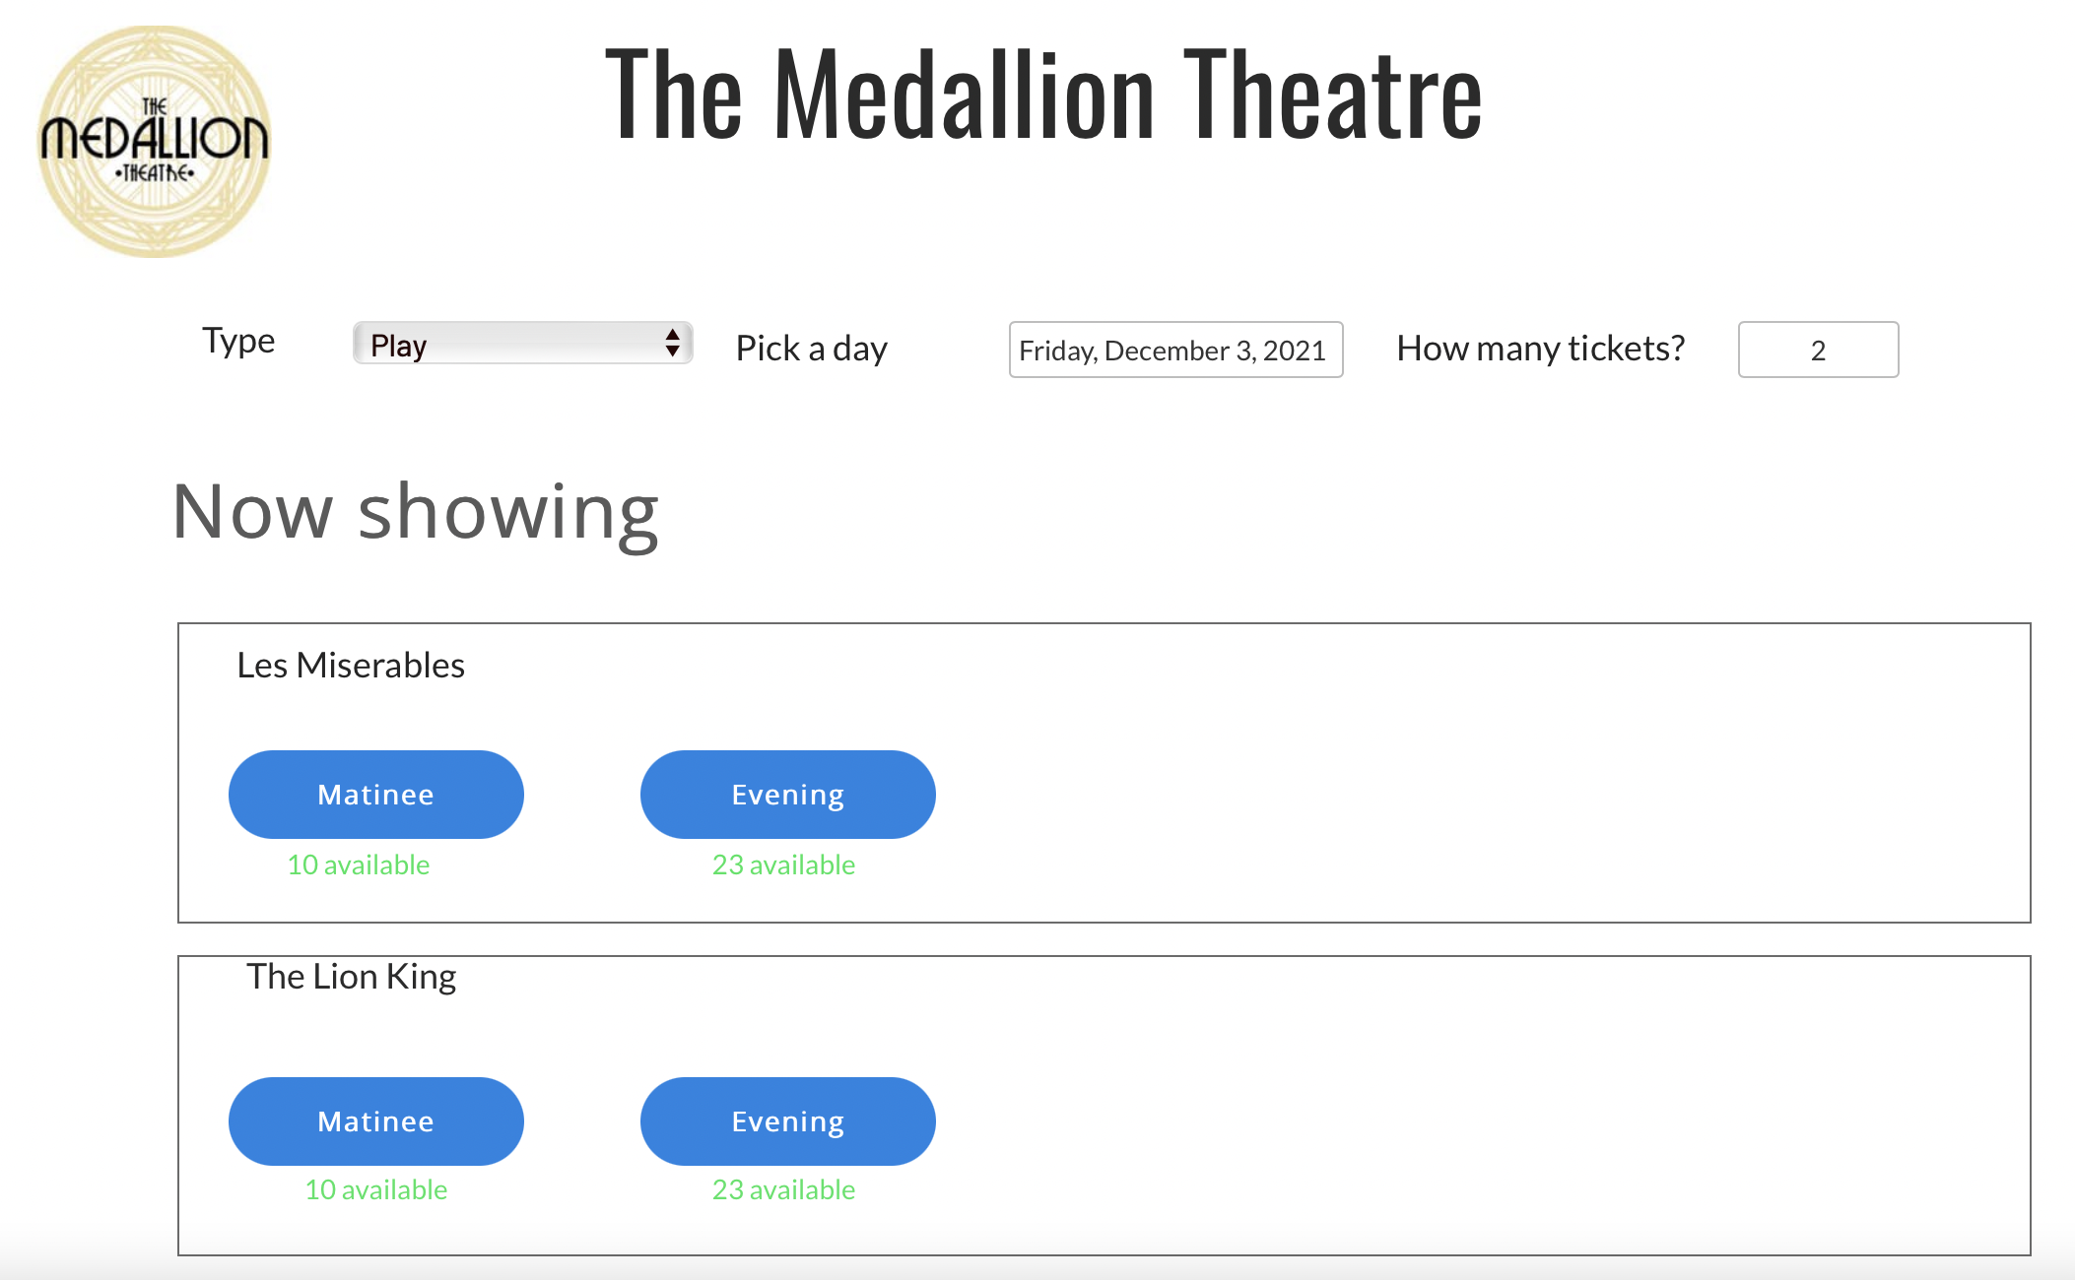
User Interface Design
This Photo by Unknown author is licensed under CC BY-SA-NC.

Slide 20
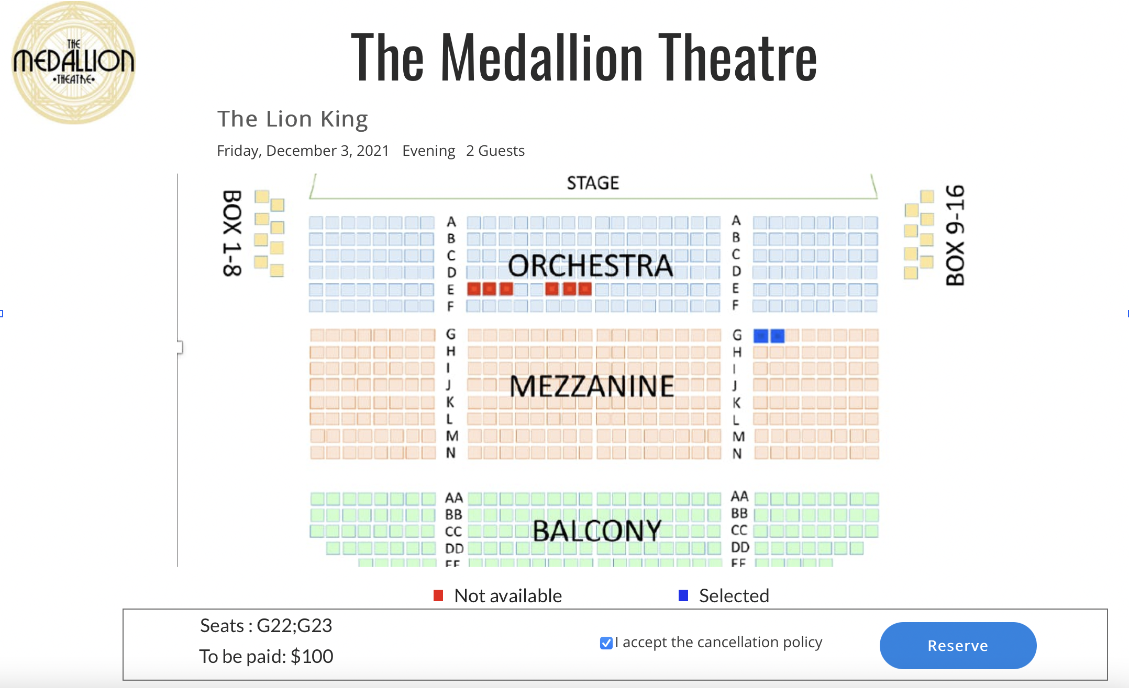
User Interface Design
This Photo by Unknown author is licensed under CC BY-SA-NC.

Slide 21
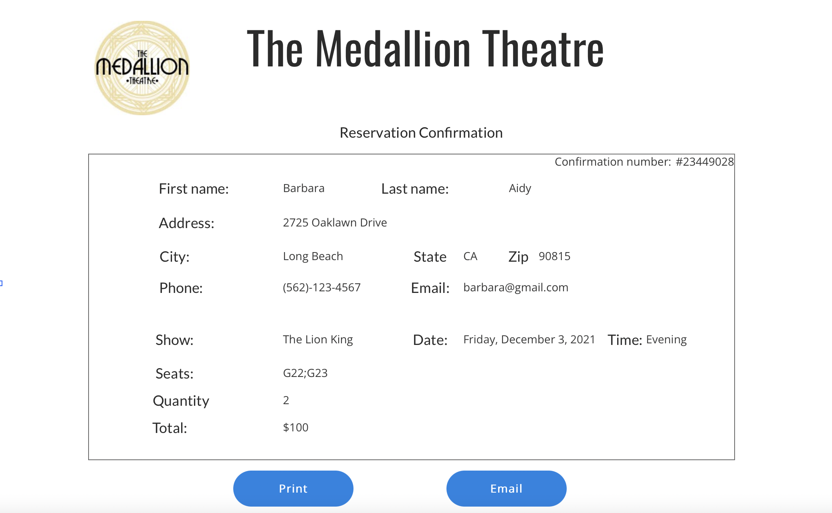
User Interface Design
This Photo by Unknown author is licensed under CC BY-SA-NC.

Slide 22

Project Report

Slide 23

Resources
HTML, CSS, JavaScript for front-end
Java and SQL for back-end

Slide 24
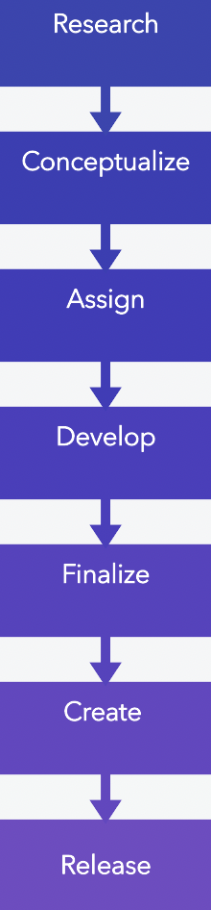
Process Flow

Slide 25
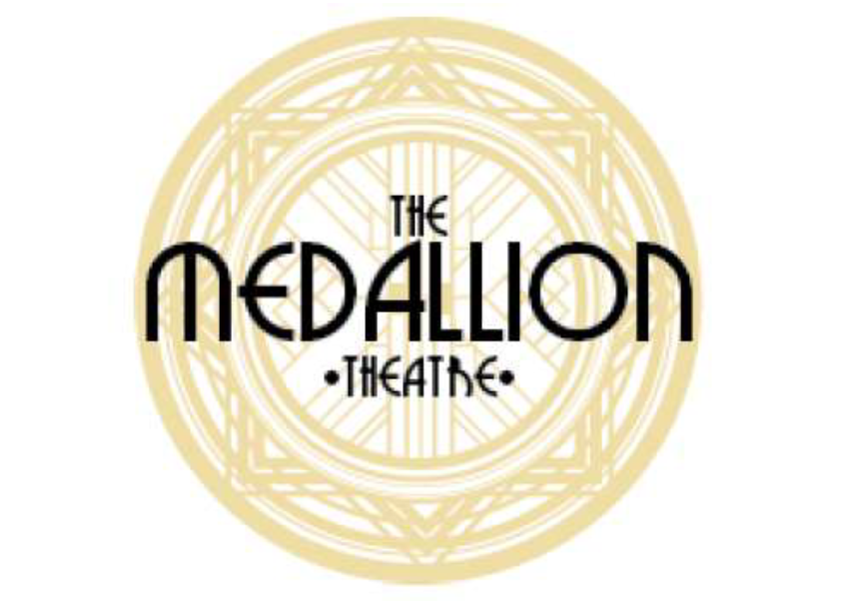
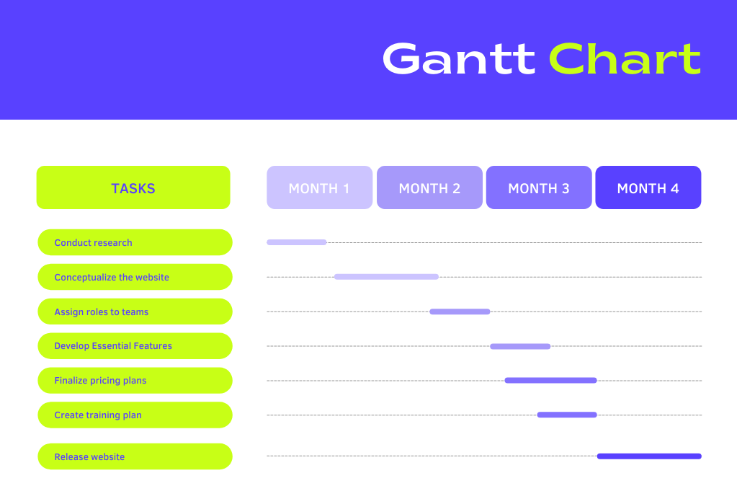

Slide 26
Post-implementation Review
Difficulties:
Properly mapping the DFDs and ER diagrams.
Straightforward:
User interface
The project roadmap and relevant resources
Achieving the outcomes of the proposal
The theatre was able to manage bookings efficiently

